Slide 1
Employee Data Analysis using Excel
STUDENT NAME: SHANKAVI.K
REGISTER NO: 312217057 (asunm1659312217057)
DEPARTMENT: B.COM (GENERAL) “C”
COLLEGE: SHRI KRISHNASWAMY COLLEGE FOR WOMEN

Slide 2
PROJECT TITLE
VISUALIZING EMPLOYEE ATTENDANCE TRENDS WITH EXCEL CHARTS

Slide 3


AGENDA
Problem Statement
Project Overview
End Users
Our Solution and Proposition
Dataset Description
Modelling Approach
Results and Discussion
Conclusion
3/21/2024 Annual Review

Slide 4

PROBLEM STATEMENT
Problem Statement:
The organization has been experiencing inconsistent employee attendance, leading to disruptions in workflow, decreased productivity, and a strain on team dynamics. The aim is to visualize attendance data to identify patterns, trends, and potential causes of absenteeism. The insights gained from these visualizations will support the development of targeted strategies to improve attendance rates, enhance employee engagement, and maintain operational efficiency.
This problem statement sets the stage for creating visualizations that focus on uncovering actionable insights to address the attendance challenges faced by the organization.

Slide 5

PROJECT OVERVIEW
Project Overview: Salary and Compensation Analysis
Project Objective:
1.Conduct a comprehensive analysis of our current salary and compensation structure.
2. Identify areas for improvement to ensure fairness, competitiveness, and alignment with business objectives.
Scope:
1.Review current salary and compensation data
2. Analyze industry benchmarks and market trends
3.Assess employee perceptions and feedback.
Timeline:
1.Data collection and analysis: [ insert timeframe ]
2.Report and recommendations : [insert timeframe]
3.Implementation : [insert timeframe]

Slide 6

WHO ARE THE END USERS?
HR Department: To identify trends, patterns, and root causes of absenteeism, and to develop strategies for improvement.
Managers and Supervisors: To monitor team attendance, address individual issues, and optimize workforce planning.
Employees: To understand attendance policies, track their own attendance, and receive feedback and support.
Executive Leadership: To oversee organizational attendance trends, allocate resources, and make data-driven decisions.

Slide 7

OUR SOLUTION AND ITS VALUE PROPOSITION
Our Solution:
1. A cloud-based attendance tracking and analytics platform.
2.Real-time attendance monitoring and reporting.
3.Automated alerts and notifications for absenteeism and tardiness.
4.Data-driven insights for informed decision-making.
Value Proposition:
1.Improve employee attendance and reduce absenteeism
2. Enhance productivity and efficiency.
3.Optimize workforce planning and resource allocation
4. Boost employee engagement and satisfaction Reduce administrative burdens and costs

Slide 8
Dataset Description
⚫ Attendance Data: Employee attendance records,
including:
+ Dates
+ Times
+ Attendance status (present, absent, late, etc.)
⚫ Employee Information: Employee demographics,
including:
+ Employee IDs
+ Names
+ Departments
+ Roles
+ Other relevant data
⚫ Date and Time: Timestamps for each attendance record,
including:
+ Date
+ Time
+ Duration of attendance

Slide 9

THE "WOW" IN OUR SOLUTION
1. Real-time Attendance Tracking: Instant updates on employee attendance, enabling prompt action.
2. Predictive Analytics: Forecasting attendance trends, identifying potential issues.
3. Personalized Dashboards: Customizable views for managers, HR, and employees.
4. Automated Alerts: Notifications for absenteeism, tardiness, or unusual patterns.
3/21/2024 Annual Review
9

Slide 10
MODELLING
Data Modeling: Entity-Relationship Diagram (ERD):
Entities:
1. Employee: Attributes include Employee ID, Name, Department, Job Title, Date of Hire, Employment Type.
2.Attendance Record: Attributes include Attendance ID, Date, Clock-In Time, Clock-Out Time, Work Hours, Attendance Status, Employee ID (foreign key).
3.Leave Record: Attributes include Leave ID, Employee ID (foreign key), Leave Type, Leave Start Date, Leave End Date, Approval Status.
4.Shift: Attributes include Shift ID, Shift Start Time, Shift End Time, Break Duration, Employee ID (foreign key).
2. Data Processing :
1.Model: ETL (Extract, Transform, Load) Process:
2. Extract: Pull raw attendance and employee data from HR systems, time-tracking software, and other relevant databases.
3.Transform: Data Cleaning: Handle missing values, correct inconsistencies, and standardize formats.
10

Slide 11
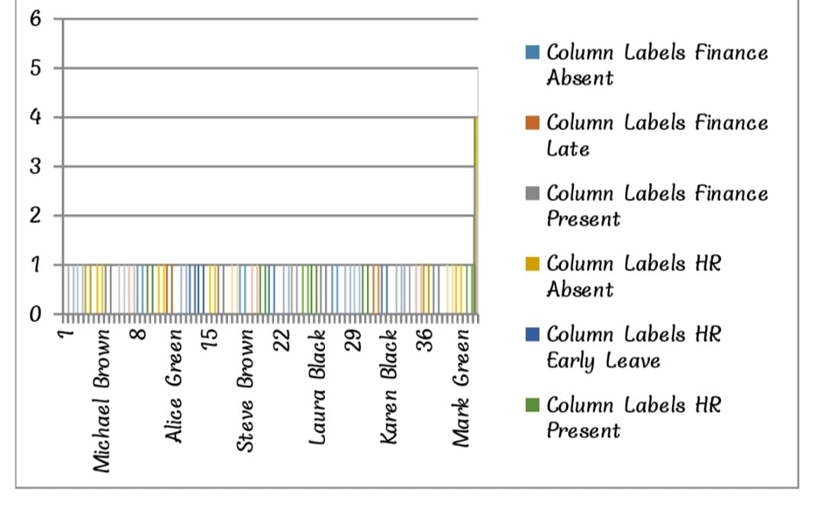
RESULTS
11

Slide 12
conclusion
In conclusion, visualizing employee attendance provides valuable insights into patterns, trends, and potential issues related to workforce management. Effective visualization helps in making informed decisions and promoting a culture of accountability and transparency within the workplace.
Effective visualization of employee attendance trends using Excel charts enables organizations to: 1. Identify patterns and anomalies in attendance data. 2. Track attendance rates over time. 3. Compare attendance across departments, teams, and locations

